Slide 1


AGE 219: Functions and
Modular Programming
School of Engineering and Technology (SoET)
Dr. Kadeghe Fue, PhD, P.Eng (T)
AI & Robotics Specialist | Office: EPAL

Slide 2
Recap: Lecture 4 Iteration
We mastered automating repetitive tasks using for and while loops to process sequences and sensor grids.

Slide 3


What is a Function?
Modularity & Abstraction
The DR Y Principle
A function is a self-contained block of code that performs a specific task. In engineering, this is the core of Modular Design.
Don't Repeat Yourself. If you need to calculate the area of 100 circles, you write the formula once inside a function and call it 100 times.
Abstraction allows you to use complex logic (like a PID loop) by just calling its name, without rewriting the math every time.

Slide 4


The Black Box Analogy
Think of a function like a machine in a workshop:
Input: Raw materials (Parameters).
Logic: The internal mechanics (Function body).
Output: The finished product (Return value).
You don't need to know how the gears work inside to get the product out.

Slide 5





Parts of a Function
Name
Parameters
Return
Unique identifier (e.g., calc_draft). Follows snake_case.
Variables that receive input data from the caller.
The final result sent back to the main program.

Slide 6

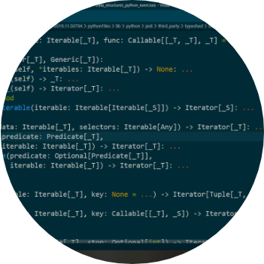
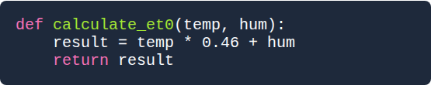
Defining with def
The Python Syntax
1. Keyword def.
2. Colon : at the end.
3. Mandatory 4-space indentation.

Slide 7
Parameters vs. Arguments
Term | Context | Definition
Parameter | Inside def | Variable names listed in the function definition (the placeholder).
Argument | Function Call | The actual values you pass into the function when you run it.
Example | Code | def func(param): vs func(arg)

Slide 8

The Power of return
Print vs. Return
Print: Just shows a value on screen. The computer "forgets" it immediately.
Return: Hands the value back to the program. You can store it in a variable for more math.
In engineering scripts, 90% of your functions should return a value.

Slide 9
Advanced Argument Design
Making your engineering tools flexible and robust.

Slide 10




Flexible Inputs
Default Arguments
Keyword Arguments
Provide a fallback value if one isn't given (e.g., gravity=9.81).
Call functions by parameter name to avoid order mistakes.

Slide 11
Variable Scope
100%
Local vs. Global
Variables created inside a function are Local. They do not exist once the function finishes. This prevents "data pollution" in large engineering projects.
Isolation
Global variables are defined outside and should be used sparingly as constants.

Slide 12
Toolbox: The math Module
Python's built-in library for scientific engineering:
math.pi / math.e (Physics constants).
math.sin() / math.cos() (Robot kinematics).
math.sqrt() / math.log10().
math.radians() (Convert degrees for AI motion).

Slide 13




Case Study 1: Implement Draft
Problem: Plow Draft
Function Solution
Predicting the force required to pull a moldboard plow through Tanzanian soil.
This modular tool can be reused for any tractor simulation.

Slide 14
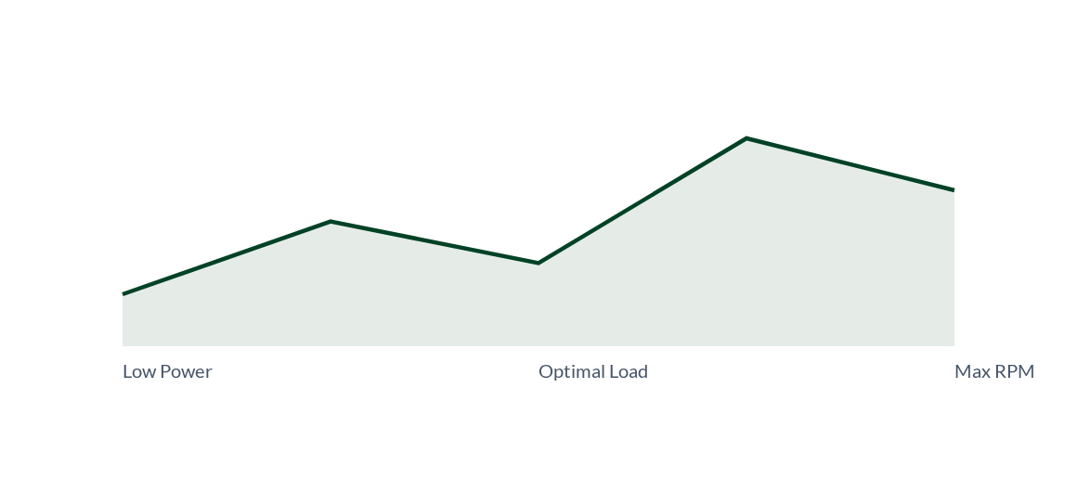
Specific Fuel Consumption Trend
Using functions to map performance allows engineers to find the "Sweet Spot" where efficiency is maximized.

Slide 15
Professional Docstrings
Documentation is 50% of good engineering code:
Always wrap documentation in triple quotes """ """.
Explain what parameters are required.
State what the function returns.
Makes your code searchable via help().

Slide 16


Questions?
Thank you for your attention.
Next Lecture: Data Structures — Lists and Dictionaries
School of Engineering and Technology (SoET) | Office: EPAL

Slide 17




Image Sources
https://upload.wikimedia.org/wikipedia/en/c/c1/SUA.png
Source: en.wikipedia.org
https://www.lkkerscm.com/uploads/upload/images/20251023/9be2e4304f646e188660ccdabc25c4ae.jpg
Source: www.lkkerscm.com
https://i.sstatic.net/8GQHb.png
Source: stackoverflow.com
https://static.vecteezy.com/system/resources/thumbnails/004/194/259/small/doodle-math-objects-border-free-vector.jpg
Source: www.vecteezy.com

